Slide 1


Social Buzz Data Insights

Slide 2


Today's agenda
Project recap
Problem
The Analytics team
Process
Insights
Summary

Slide 3

Social Buzz is a fast-growing small business that needs to adapt to a global scale quickly. Accenture has begun a 3-month POC focusing on these main tasks:
Audit of best big data practices at Social Buzz
Recommendations for a successful IPO
An analysis of content highlighting the top 5 categories with the largest aggregate popularity
Project Recap

Slide 4

Problem
Unstructured big data to analyze before IPO
Over a 100,000 posts per day
But how to capitalize on this?

Slide 5



Myself
Data Analyst
The Analytics team
Marcus Rompton
Senior Principle
Andrew Fleming
Chief Technical Architect

Slide 6
Process
1
Understanding the Data
2
Data Cleaning
3
Data Modelling
4
Data Analysis
5
Draw Insights

Slide 7
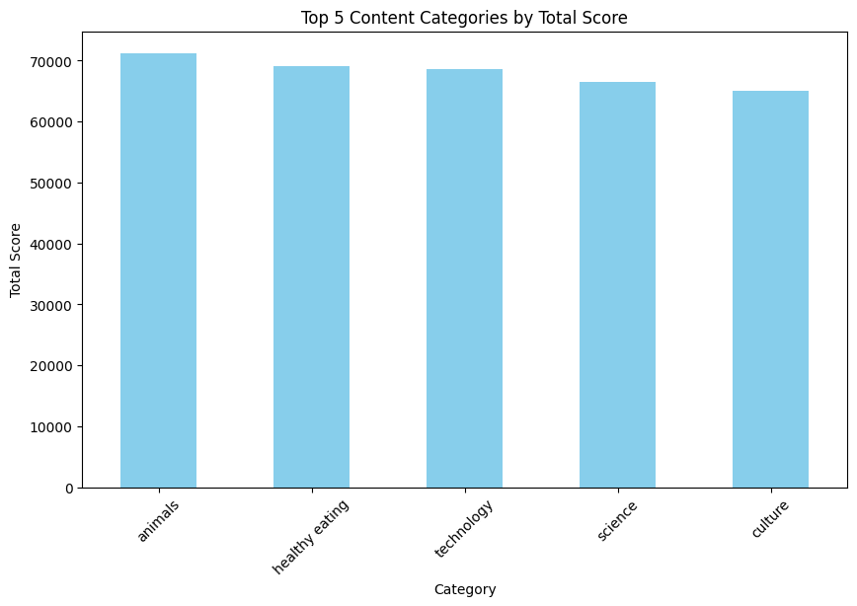
Insights

Slide 8
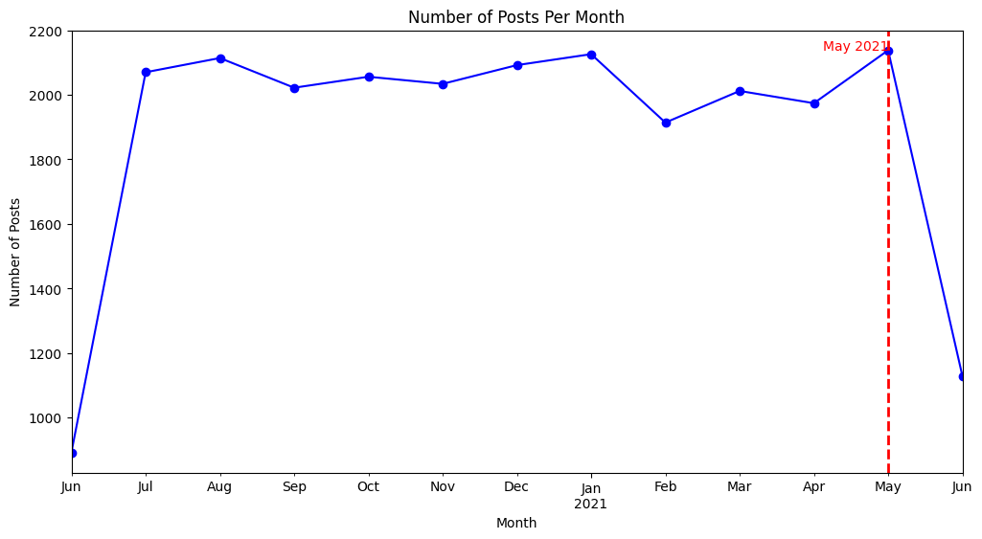
Further Insights
Most engaging month “May 2021” with a total of 2,138 posts.

Slide 9
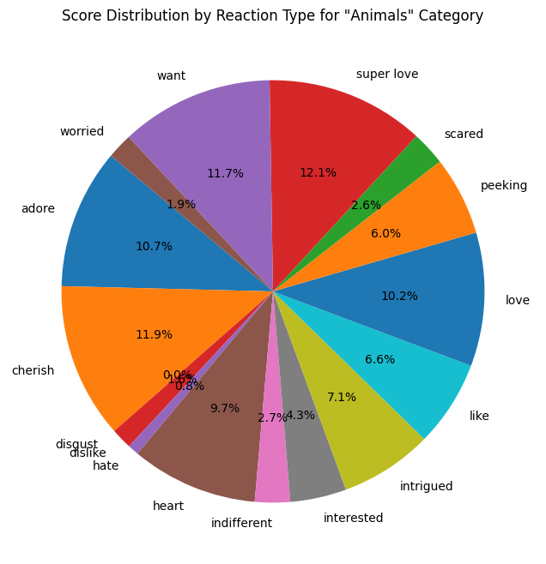
Animal results in Top Category with over 1800 different reactions

Slide 10


There are over 29 unique categories from which “Animals” is the most engaging, shown in pie chart.
Top 5 categories have also been displayed in a bar chart.
The month with the most engagement with posts was May 2021 with over 2100 posts, entailed in the time series plot.
Summary

Slide 11
Thank you!
ANY QUESTIONS?

